Slide 2
Introduction to Causality

Slide 3
C_{NPMR}
Explain cnpmr

Slide 4
Faes
Explain faes handwavy.
Give better name

Slide 5
Sensitivity

Slide 6
Experiments
Artificial
Eeg

Slide 7







Experiment 1: Unidirectional Nonlinear Model
$$x_{1}\left(t\right)=0.8x_{1}\left(t−1\right)+0.65x_{2}{\left(t−1\right)}^{2}+e_{1}\left(t\right)$$
$$x_{2}\left(t\right)=0.6x_{2}\left(t−1\right){+e}_{2}\left(t\right)$$
RIM FILL IN FAES ARROWS FOR SIGNIFICANT CAUSALITIES
Actual
C_{NPMR}
Faes
$$x_{1}$$
$$x_{2}$$
$$x_{1}$$
$$x_{2}$$
$$x_{1}$$
$$x_{2}$$

Slide 8








Experiment 2: Multivariate Linear Model
$$x_{1}\left(t\right)=0.95\sqrt{2}x_{1}(t−1)−0.9025x_{1}(t−2)+e_{1}\left(t\right)$$
$$x_{2}\left(t\right)=−0.5x_{1}\left(t−1\right)+e_{2}\left(t\right)$$
$$x_{3}\left(t\right)=0.5x_{3}\left(t−1\right)−0.5x_{2}\left(t−1\right)+e_{3}(t)$$
RIM FILL IN FAES ARROWS FOR SIGNIFICANT CAUSALITIES
Actual
C_{NPMR}
Faes
$$x_{1}$$
$$x_{2}$$
$$x_{1}$$
$$x_{2}$$
$$x_{1}$$
$$x_{2}$$
$$x_{3}$$
$$x_{3}$$
$$x_{3}$$

Slide 9









Experiment 3: Multivariate Nonlinear Model
RIM FILL IN FAES ARROWS FOR SIGNIFICANT CAUSALITIES
Actual
C_{NPMR}
Faes
$$x_{1}$$
$$x_{2}$$
$$x_{1}$$
$$x_{2}$$
$$x_{1}$$
$$x_{2}$$
$$x_{3}$$
$$x_{3}$$
$$x_{3}$$

Slide 10

Experiment 4: Henon Maps
$$x\left(t\right)=1.4−x{\left(t−1\right)}^{2}+0.3x(t−2)$$
$$y\left(t\right)=1.4−\left[cx\left(t−1\right)+\left(1−c\right)y\left(t−1\right)\right]y\left(t−1\right)+0.1y(t−2)$$

Slide 11
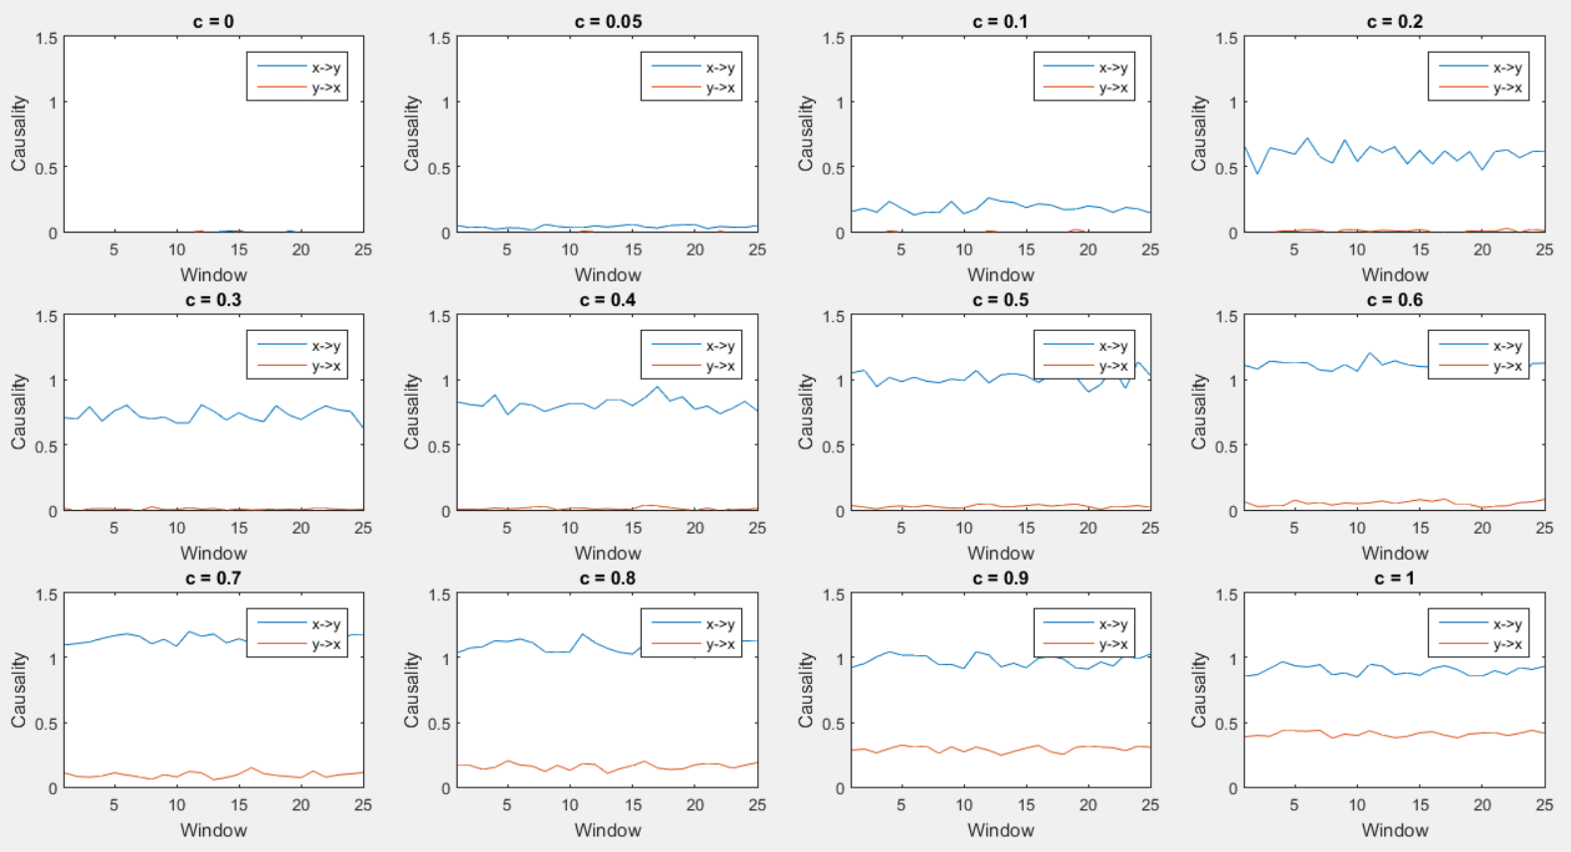
Experiment 4: Henon Maps

Slide 12
RIM PUT 3X4 PLOT OF FAES HERE

Slide 13
RL system

Slide 14
Windowing??

Slide 15
EEG Data

Slide 16
Frequency causality??

Slide 17
Summary / conclusion

Slide 18
Next period

